Slide 1
Autism
Taylor Raymond & Bryan Kay

Slide 2
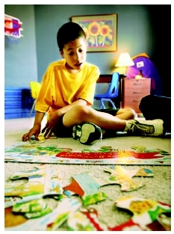
What is Autism?
A brain disorder that often makes it hard to communicate with and relate to others.
Different areas of the brain fail to work together.

Slide 3
Statistics
Appears before age 3
Diagnosed four times more often in boys than girls
Does not affect life-expectancy
Prevalence not affected by race, region, or socio-economic status
Occurrence of Autism in the U.S. has climbed to one in every150 people

Slide 4
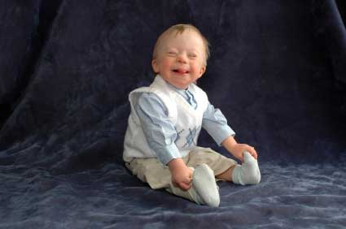
Causes of Autism
Inherited
Medical Problems at Birth
Childhood vaccines

Slide 5
Symptoms of Autism
Delay in learning to talk
Not talking at all
May seem to be deaf
Repeated and overused types of behavior
Rocking, attachment to objects, tantrums
Below-normal intelligence
Depression
Anxiety
Obsessive-compulsive
Seizures

Slide 6
Treatments for Autism
Special Behavioral Training
Positive reinforcement
Build social skills
Speech Therapy
Physical Therapy
Music Therapy
Canine Companions
Medicine

Slide 7
Misconceptions of Autism
Autism is a psychological condition.
Truth: It is a physical condition determined by differences in how the brain works.
Autistic people are mentally retarded.
Two separate disorders. 80% of people diagnosed with autism have some degree of mental retardation.
Autistic people are geniuses or super intelligent.
Autism is an uneven development of skills.
(1:40-5:00)
http://www.youtube.com/watch?v=KtmVMrAUcR8

Slide 8
Teaching a Student with Autism
Get in touch with therapist/doctor
Use consistent classroom routines
Give visual instructions
Plan breaks
Create a self-calming area
(chair, couch, bean bag)
Create a sensory area
(building blocks, koosh balls, squeeze toys, listening center)

Slide 9
Teaching a Student with Autism
Create hand signals and signs
Provide menu of appropriate behaviors
Set up and practice transition activities
Collaborate on assignments
Highlight directions
Explain purpose of assignments
Assign specific role in
group work
Use student interests

Slide 10
Resources
Changing the Course of Autism, Bryan Jepson, MD
Louder Than Words, Jenny McCarthy
National Autism Association: http://www.nationalautismassociation.org/
Teaching Autism Students: http://www.child-autism-parent-cafe.com/
Lesson Plans for Autistic Children: http://autism.lovetoknow.com/Lesson_Plans_for_Autistic_Children

Slide 11
TE 803 Special Ed Wiki
http://te803sped2010.pbworks.com/

